Slide 1
0x109 – Industrial Control Systems
ECED4406 – Computer Security
Dr. Colin O’Flynn
Dalhousie University.

Slide 2
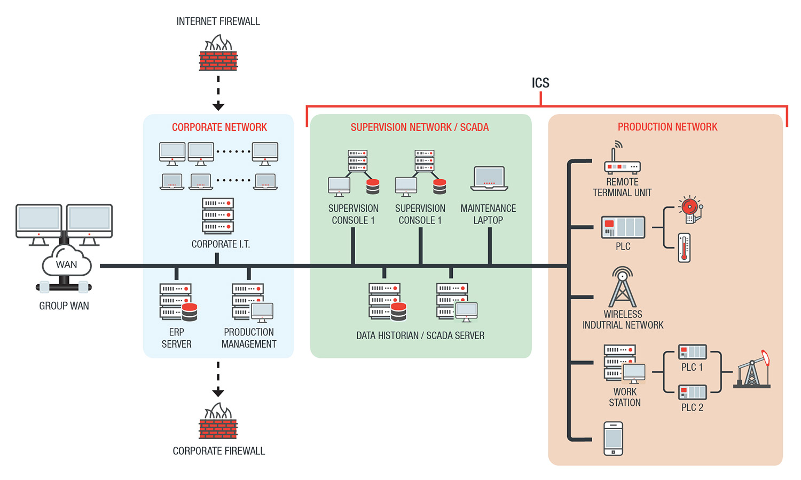
Industrial Control System (ICS)
https://www.trendmicro.com/vinfo/us/security/definition/industrial-control-system

Slide 3
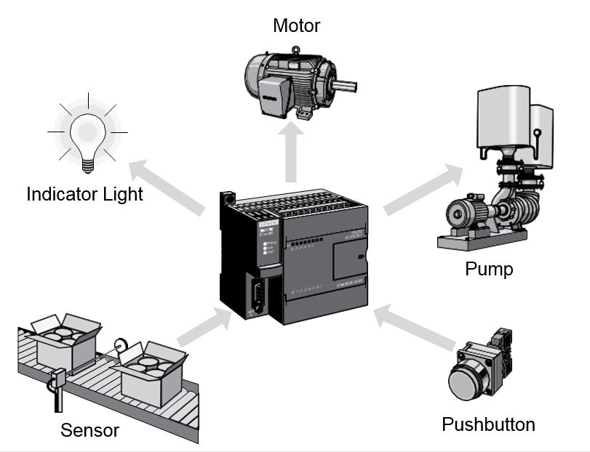
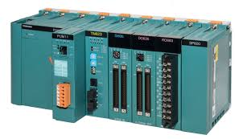
Programmable Logic Controller (PLC)

Slide 4
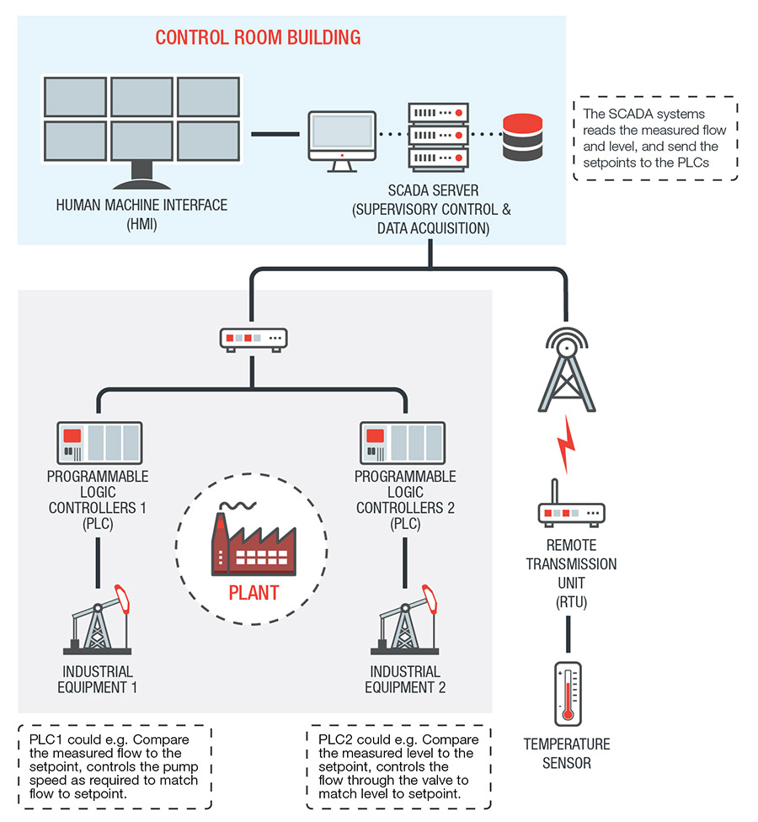
Supervisory Control and Data Acquisition (SCADA)
https://www.trendmicro.com/vinfo/us/security/definition/industrial-control-system

Slide 5
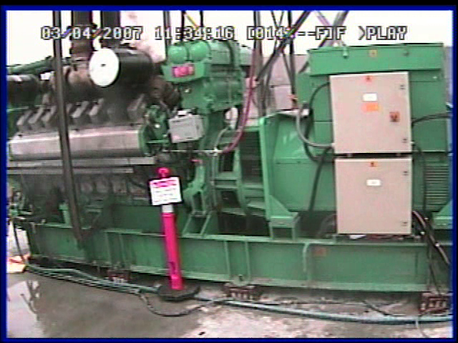
Example: Aurora Generator Test
https://www.youtube.com/watch?v=fJyWngDco3g

Slide 6

Ukraine power grid cyberattack
Multi-step attack, including:
Compromise of corporate network.
Switching substations off using SCADA control.
Disabling some IT infrastructure to make recovery more difficult.
Wiping of servers / workstations.
https://en.wikipedia.org/wiki/December_2015_Ukraine_power_grid_cyberattack

Slide 7
Considerations for these networks
Often high-cost, but niche products that may not have had extensive security validation.
Many older networks suddenly become internet-connected (without considering security implications!).
Only small part of it is embedded system – majority of attack is “more standard” cybersecurity work.

Slide 8
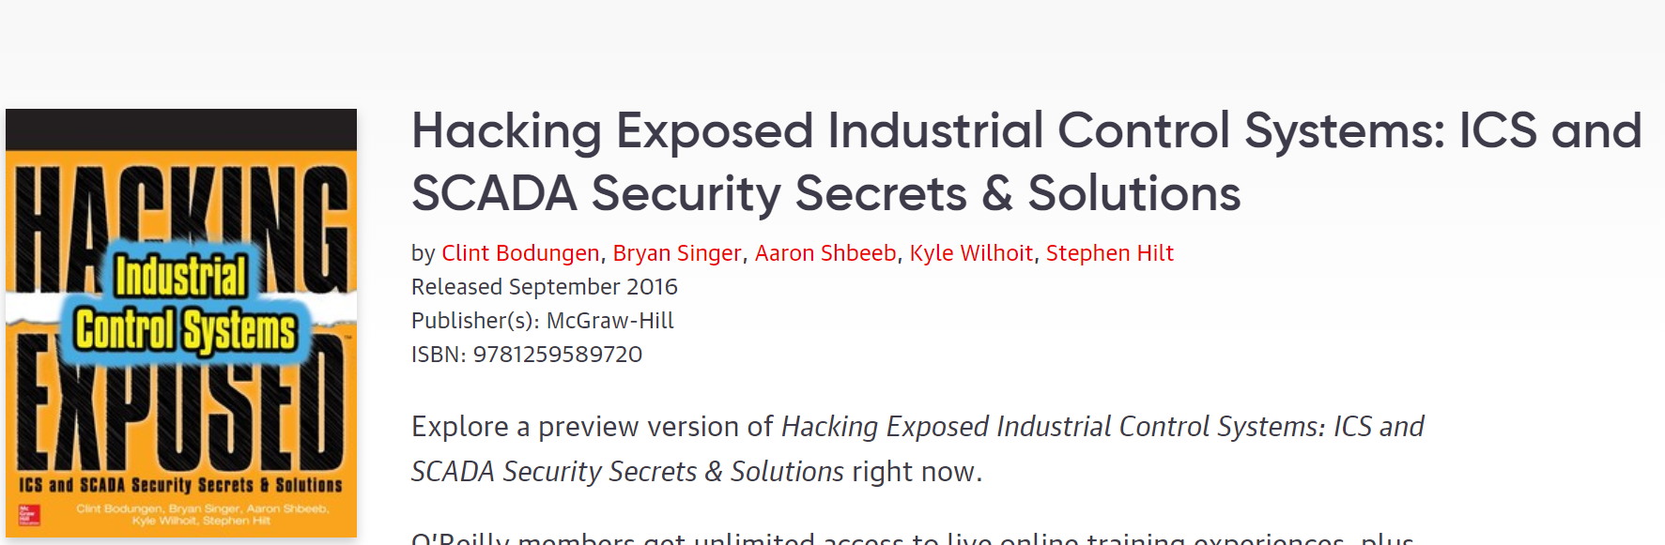
Getting Started

